Slide 1
𝛴:Sigma Consulting
THE PARTNERTS THAT ADD VALUE TO YOUR COMPANY
By:
Llamas Daniel
López Iván
Macías Luis
Ramirez JuanFer
Villarreal Jorge

Slide 2

Covid MythBusters 🚫
More people will die out hunger
Most relevant correlation to covid Deaths are diabetes, heart diseases and GDP or GDP PPP (Purchasing Power Parity) per capita
Richer countries/Cities get less covid than poorer
Less concentrated places get less covid deaths

Slide 3
Used Methods
Linear Regression
Multivariate analysis
Multiple variable correlation

Slide 4
Sources
Wold Bank API
FAO Data Base (CSV)
John Hopkins API and CSV
Our World in Data (CSV)

Slide 5
Myth 1. More People will die out of hunger
Main Hypothesis: Expected reduction in economic crisis will have a much bigger impact on deaths per million than Covid
Process:
1. Get data sources
2. Find linear regressions on historic deaths per million to proyect figures for 2020-2022
3. Find correlation between nutrition as a proxy to hunger, GDP per capita and deaths per million
4. Project expected incremental deaths based on lower thatn expected GDP per capita
5. Compare Death levels

Slide 6
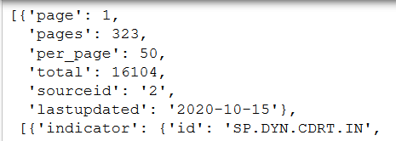
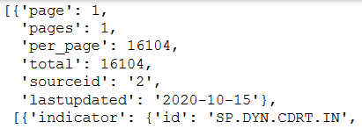
Data Sourcing First Query
http://api.worldbank.org/v2/country/all/indicator/SP.DYN.CDRT.IN?format=json
𝛴:
Second Query
total_registers = response[0]["total"]
f"http://api.worldbank.org/v2/country/all/indicator/SP.DYN.CDRT.IN?format=json&per_page={total_registers}"

Slide 7

Function to call API and get only the information needed

Slide 8
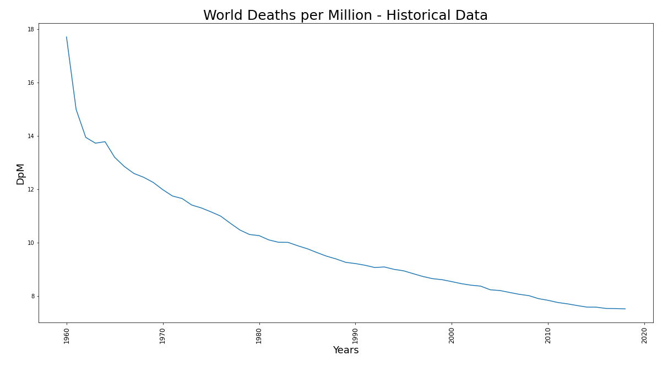
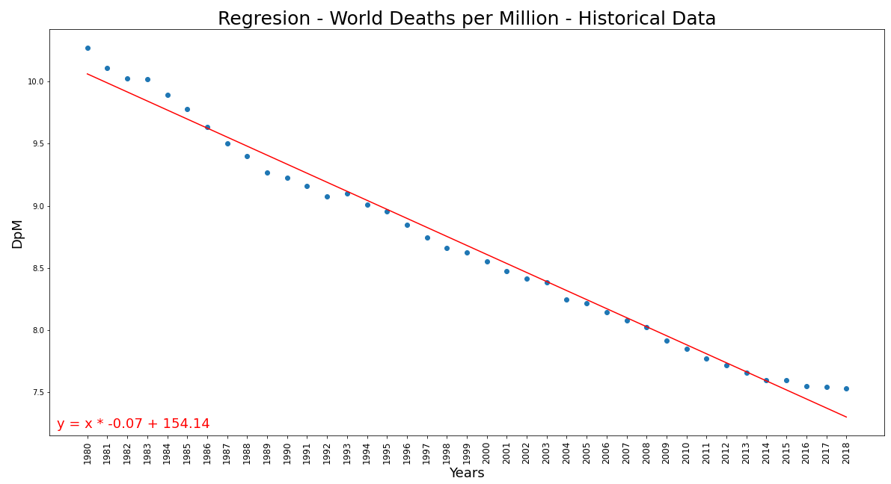
2. Find linear regressions on historic deaths per million to proyect figures for 2020-2022
Y= X*(-.07) + 154.14
R-squared=.9875
Predictions:
2020: 7.15 DpM
2021: 7.08 DpM
2022: 7.01 DpM
The expected Deaths per Million Habitants in the World based on historical data is: 2020: 7.15 2021: 7.08 2022: 7.01

Slide 9
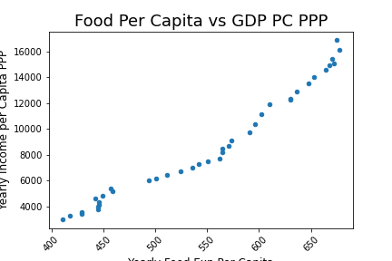
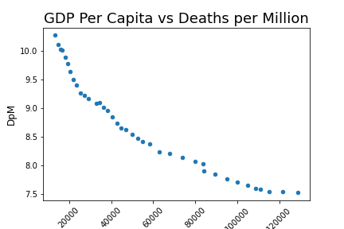
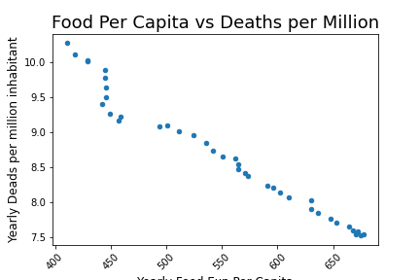
3. Find correlation between nutrition as a proxy to hunger, GDP per capita and deaths per million
Analysis:
There is a clear correlation between yearly cost of food per capita in the world and the GDP PPP per capita, both variables highly correlate to the decrease in deaths per million in the world. We can infer that average world hunger could be measured by GDP per capita and a change in trend will revert reduction trend of hunger deaths.

Slide 10
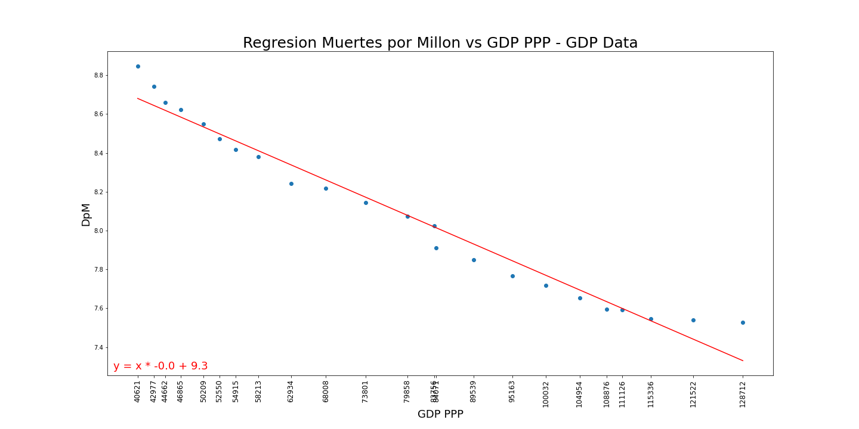
4. Project expected incremntal deaths based on lower than expected GDP per capita
Y= X*(-1.5e-5) + 9.303
R-squared=.9674
Predictions:
2020: 7.31 DpM
2021: 7.16 DpM
2022: 7.03 DpM
Analysis:

Slide 11

5. Compare Death levels
Year | DpM_Historic | DpM_GDP | Delta | Deaths due Crisis
2020 | 7.307578 | 7.152307 | .155271 | 1,195,586
2021 | 7.159862 | 7.079542 | .080320 | 618,465
2022 | 7.031353 | 7.006777 | .024575 | 189,229
Total Deaths by Economical Crisis : 2,003,280

Slide 12
Myth 2-3. Biggest correlating variables on Covid deaths are Diabities and Heart Desease and negative correlation exist to GDP per capita
Main Hypothesis: Countries income will impact in hability to have lower COVID deaths and pleaces with higher Diabeties and Heart deases rates will have a higher Covid death rate
Process:
1. Get data sources and preparing DataFrames
2. Univariate Model between GDP per Capita and Covid Deaths
3. Multivariate analysis to determine variables with more correlation to Covid Deaths
4. Arrive to conclusions

Slide 13
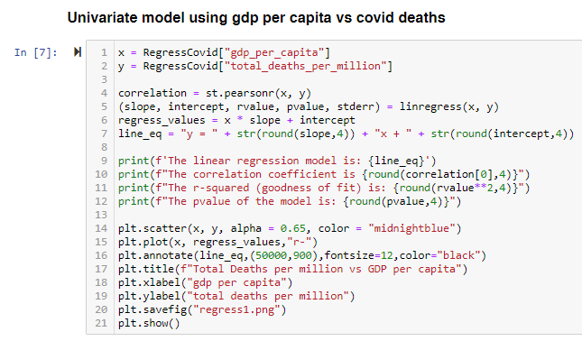
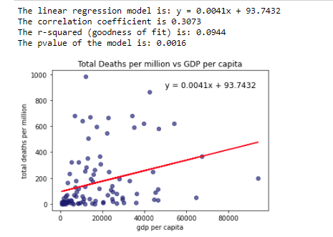
Myth 2: The larger the GDP per Capita the Lower the Covid Deaths
Regression model to determine the correlation between the GDP per Capital and Covid Deaths, using GDP as predictor
Despite the model has statistical significance, no strong correlation exists between GDP per Capita and Covid Deaths

Slide 14
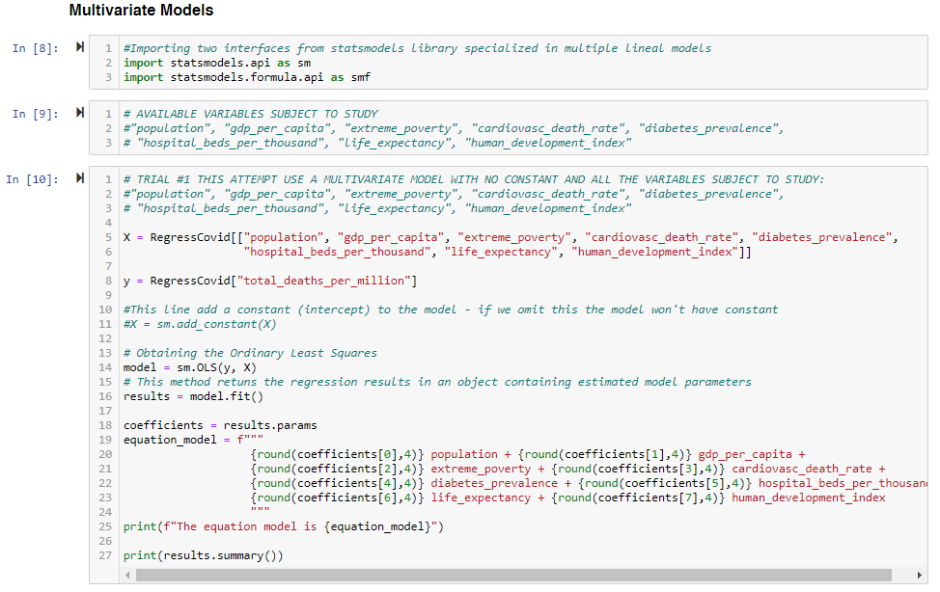
Myth 3: Strong correlation between Covid deaths and Diabities and Heart Desease
Multivariate Analysis to determine those variables with the strongest lineal relationship with Covid Deaths

Slide 15
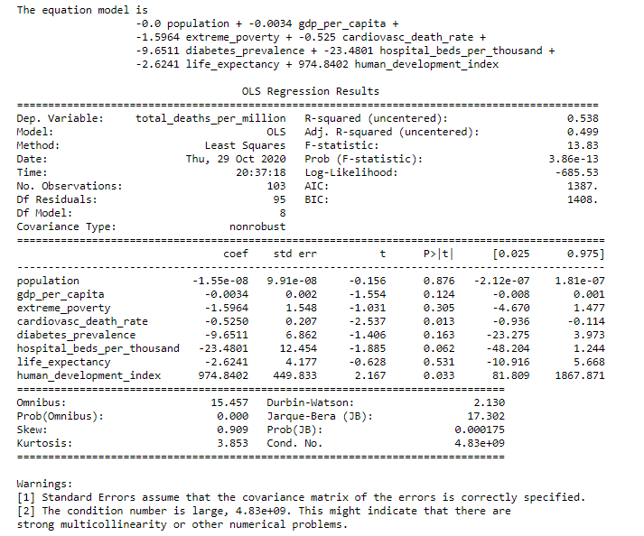
Myth 3: Strong correlation between Covid deaths and Diabities and Heart Desease
Trial #1 Multivariate Analysis using 8 variables

Slide 16
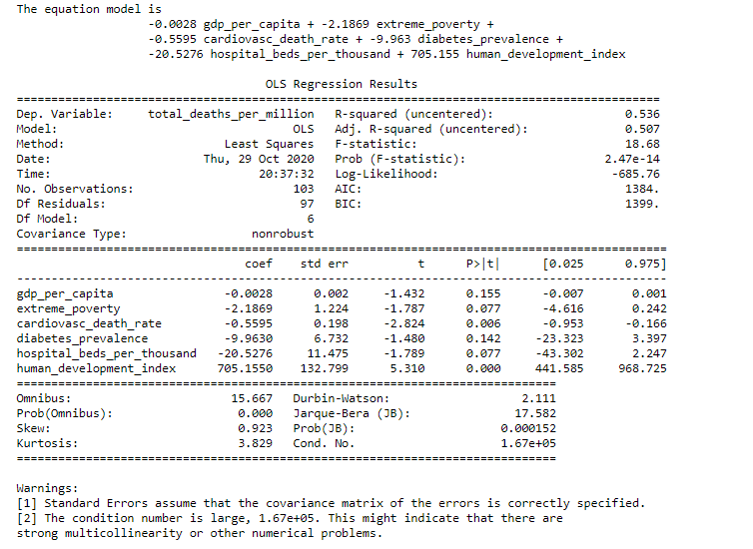
Myth 3: Strong correlation between Covid deaths and Diabities and Heart Desease
Trial #2 Multivariate Analysis dropping «population» and «life expectancy»

Slide 17
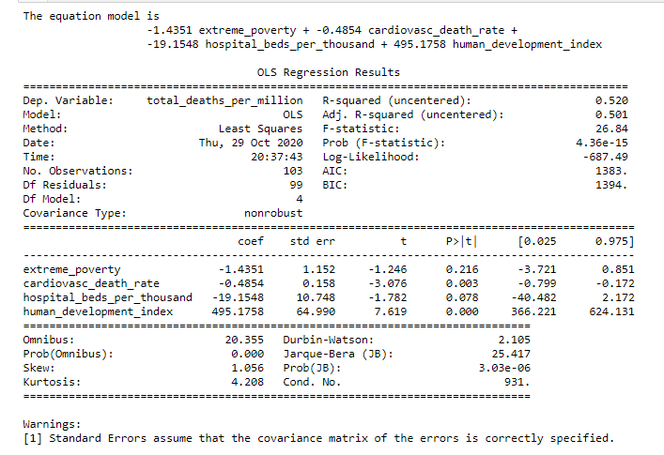
Myth 3: Strong correlation between Covid deaths and Diabities and Heart Desease
Trial #3 Multivariate Analysis dropping «gdp per capital» and «diabetes prevalence»

Slide 18
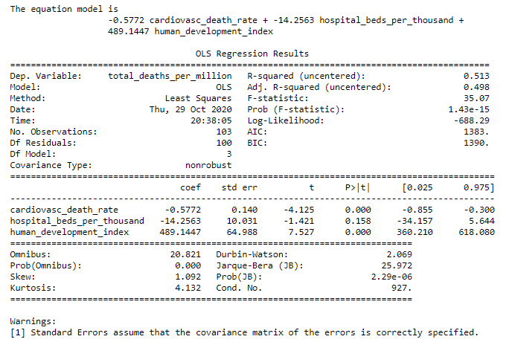
Myth 3: Strong correlation between Covid deaths and Diabities and Heart Desease
Trial #4 Multivariate Analysis dropping «extreme poverty»

Slide 19
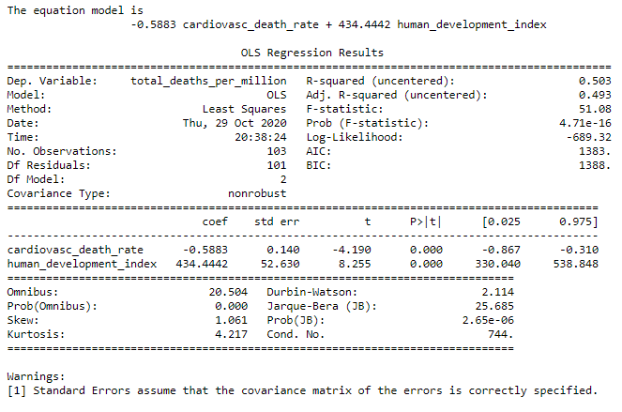
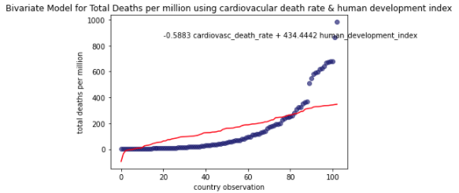
Myth 3: Strong correlation between Covid deaths and Diabities and Heart Desease
Final Multivariate Model using only cardiovascular death rate and human development index
Using a Bivariate model with cardiovascular death rate and human development index has a predictive power of 50.3% of the variance of Covid Deaths

Slide 20
Myth 4. Cities with higher density will have higher Covid death rates and cities with higher GDP per capital will have lower
Main Hypothesis: There is a correlation between density and deaths and a negative correlation between GDP per capita and deaths
Process:
1. Get data sources
2. Find correlations between variables
3. Arrive to conclusions

Slide 21
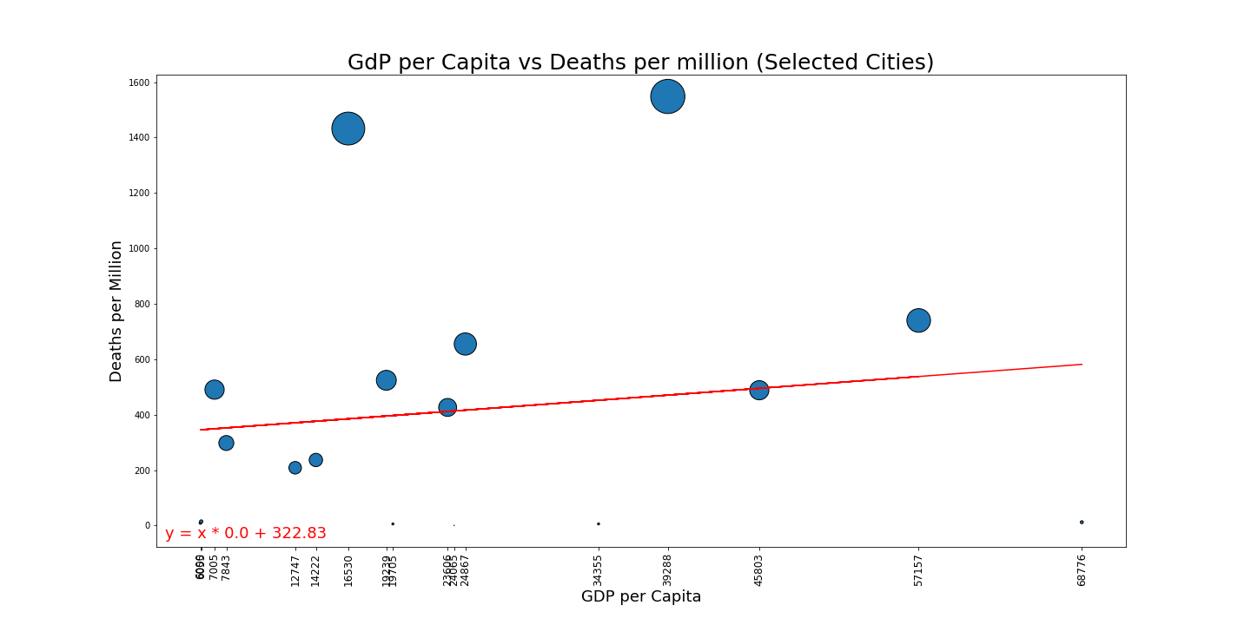
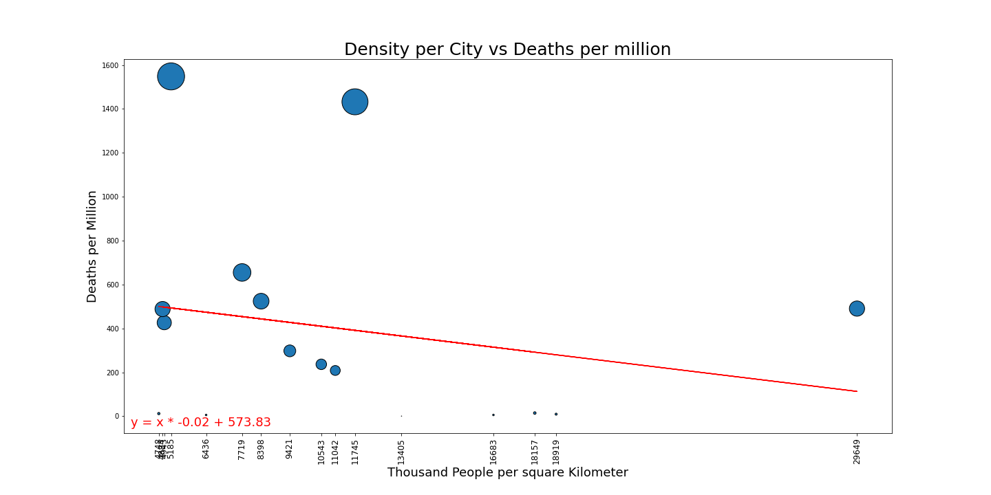
Linear Regression:
Dani, ensayate explicar esto en 2 minutos. Habla de los outlies como Mumbay que tiene alta densidad y muertes promedio vs Madrid que tiene muy poca densiad y muchas muertes
Y terminar con la conclusion clara de que no hay correlacion (lo que dice el texto)
Conclusions. In the selected 16 Cities covering all continents and hemispheres theres is no relevant informaiton to conclude that a correlation or a negative correlation exist between density, GDP per capita and deaths per million. Information could be impacted by timing and intensity of closings and quality of the reported data

